Slide 1
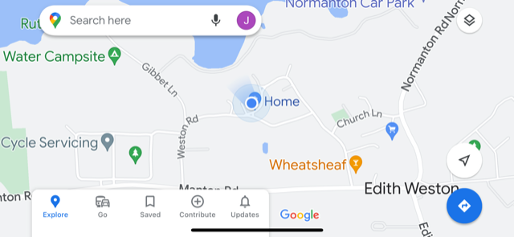
New post & sign
New sign on existing pole

Slide 2
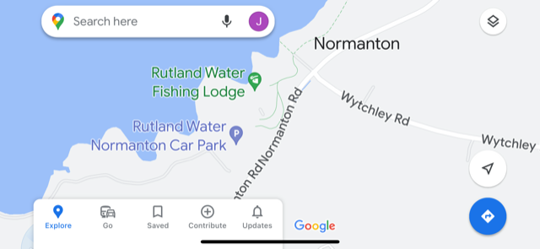
New post & sign
New sign on existing pole

